Slide 1
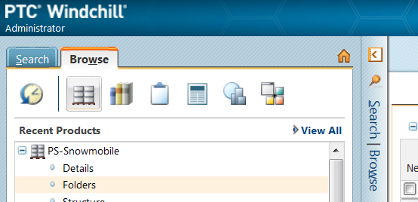


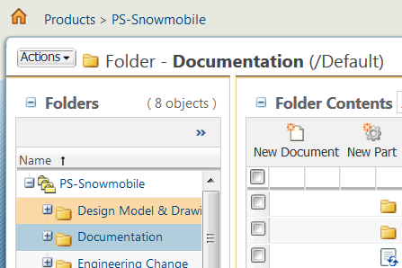
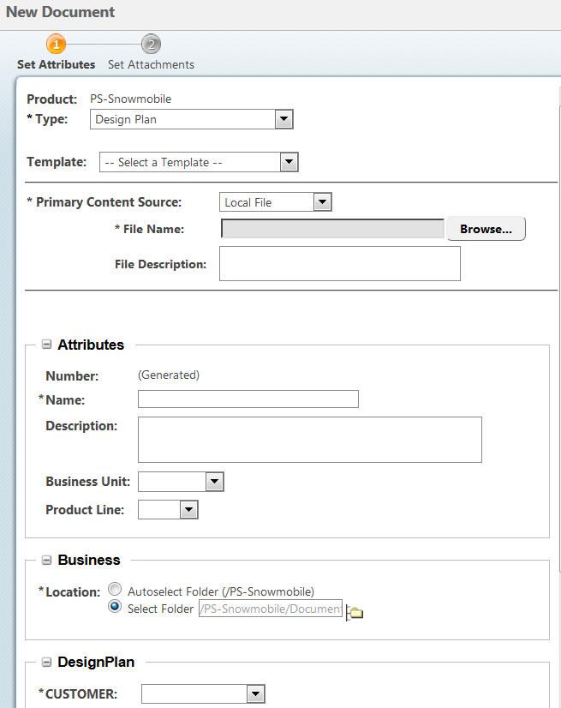
How to Create a Document in Windchill
a. Open the navigator pane.
b. Click the folder link under the product where you want to create the document.
a
1 goto product
NOTE: if your product is not visible click the View All link
b
CAUTION: Read the instructions in sequence. Actions in point 2 should not be done before completing point 1.
c. In the product Browse to the right folder.
d. Click New Document
2 Browse
d
c
In the new Document:
e. Select type.
f. Select the template (if needed)
g. Browse for the document.
h. Fill the parameters.
i. hit finish
e
f
g
3 Fill the form
h
NOTE: Mandatory attributes are mark with an *

